Slide 1
How my program validates UPC-A barcodes (and how it works generally)
Brett Day
SDEV 140
Midterm Project
upc_checker.py

Slide 2
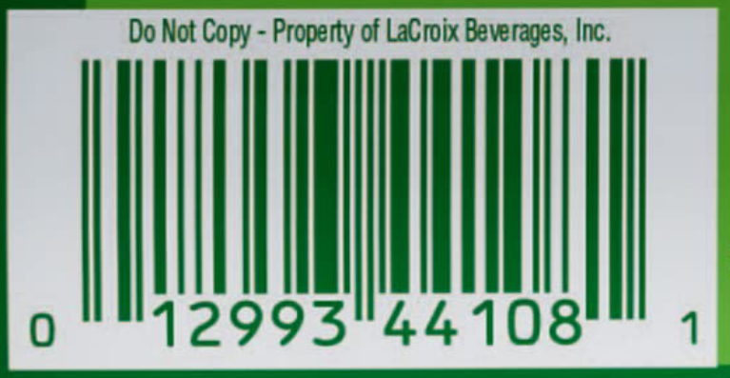
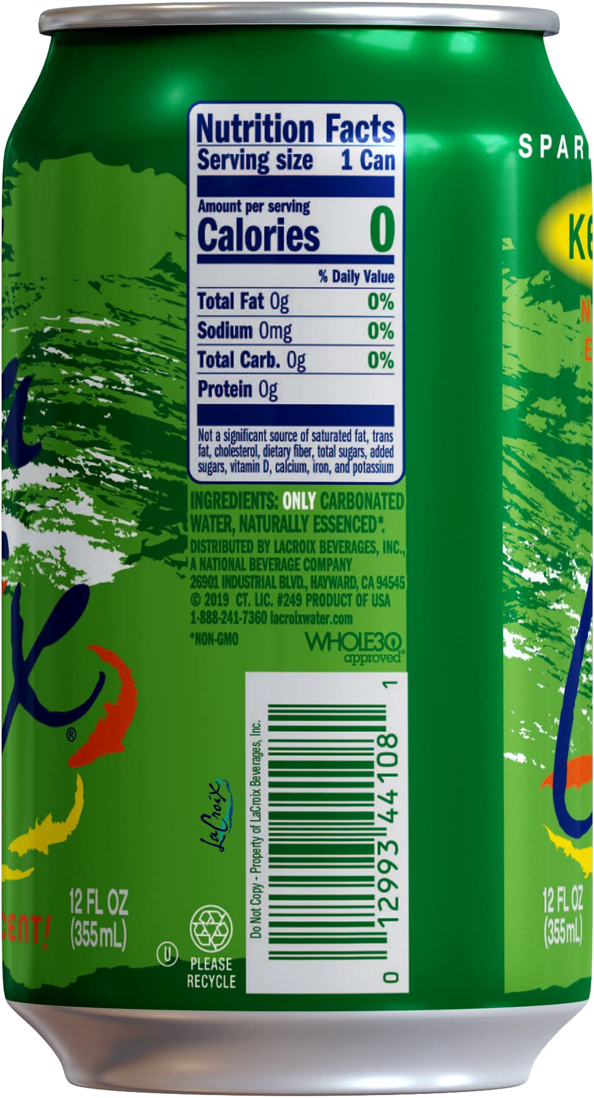
La Croix “Key Lime”
UPC-A Basics:
First add up all the odd positions, then * 3.: (1,3,5,7,9,11)
(0+2+9+4+1+8) = 24 * 3 = 72
Then, add up even positions excluding checksum: (2,4,6,8,10).
(1+9+3+4+0) = 17
Add the odd value and the even value.
(72 + 17) = 89
Divide by 10, then evaluate the remainder.
89/10 = 8 (Remainder 9).
Then, subtract 10 – [remainder], and it should = checksum.
In this case, 10-9=1, and since 1=1, this is a valid UPC.

Slide 3
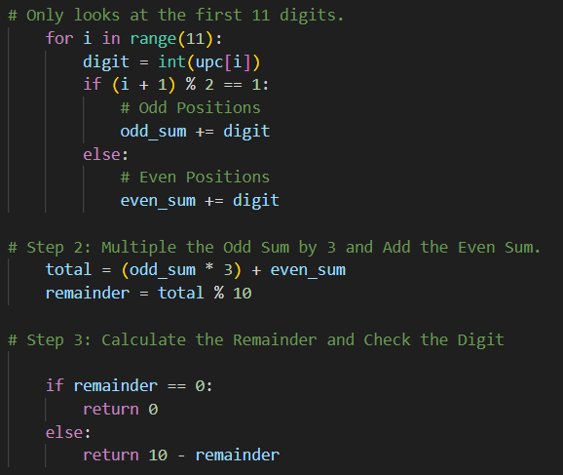
How my program executes the math!
Only looks at the first 11-digits.
Makes each digit an integer
Starts counting at 1 instead of 0, since UPC’s do that.
The condition for an odd integer (1,3,7,9,11) (0 (first odd position) +1 = 1%2 == 1, odd digit.
The condition for an even integer (2,4,6,9,10) (1+1 = 2%2 !== 1, odd digit.
Adds the (odd_sum * 3) to the even sum, then takes the remainder.
If the remainder is 0, then the checksum should be 0. If the remainder is anything, then the checksum should be that value.

Slide 4
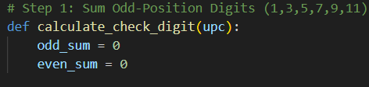
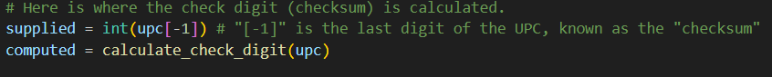
How my program validates the UPC!
Define the variable “calculate_check_digit(upc)”. Whatever the remainder is from the previous loop gets assigned to this variable.
Here the actual checksum is compared against the calculated UPC. All the code below this point only focuses on the various different print(“”) statements that can come about depending on the result of this code.

Slide 5
I used lots of help
UPC-A Barcodes 4 Dummies. This is about the first website I read for this project.
"Checksum Sanity Check". This quickly calculates the checksum for barcodes, I used this to helpp verify the math functions of my program were working.
"%" Modulo operator 4 dummies. I found out I needed this for the remainder, but didn't know how to use it. I used this website for quite a bit of the math to python functions.

